Slide 2
MSc project
Julia Sizova

Slide 3

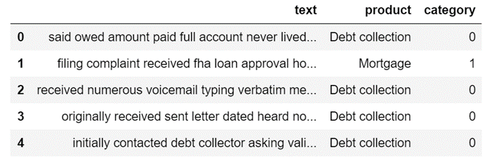
Customer complaints
Customer complaints for US financial institutions
Dimensions: (1 321 785 × 18) -> (263 712 × 2)

Slide 4
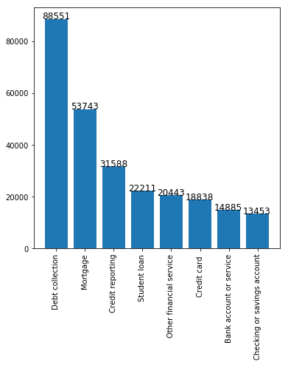
Customer complaints
8 categories
Text vectorization: Tf-idf of 10,000 most frequent words
Categories are encoded by integers
Baseline accuracy: 0.34

Slide 5
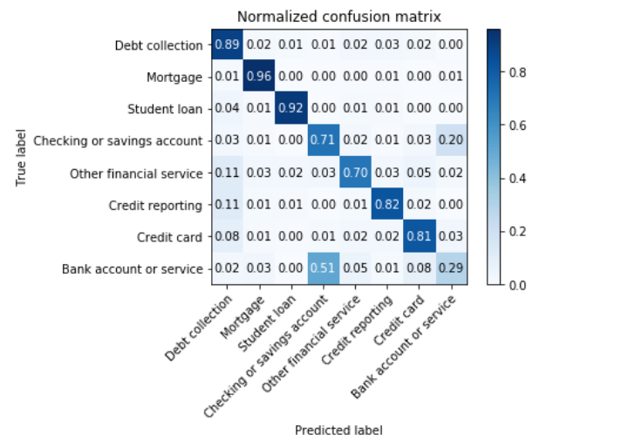
Customer complaints
Confusion matrix for neural net on test set
Sklearn classifiers: 0.81 test accuracy
Neural network with 5 densely connected layers: 0.84 test accuracy
To halt overfitting:
dropout,
max norm weight constraint,
batch normalization,
early stopping
Confuses two classes

Slide 6
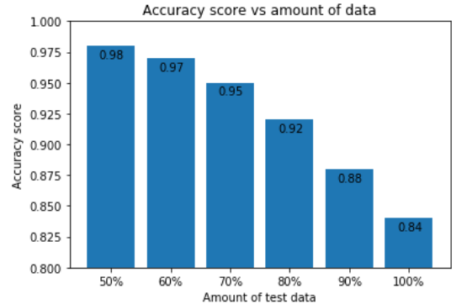
Customer complaints
Different way of presenting results
Predictions are sorted by the highest probability
For the first half of test data algorithm is 98% present sure about the prediction

Slide 7
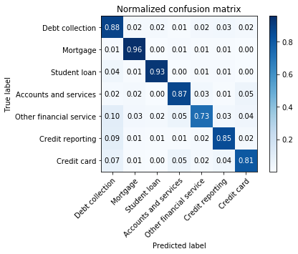
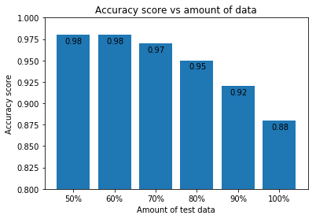
Customer complaints
Combining ambiguous categories
Test accuracy: 0.88

Slide 8
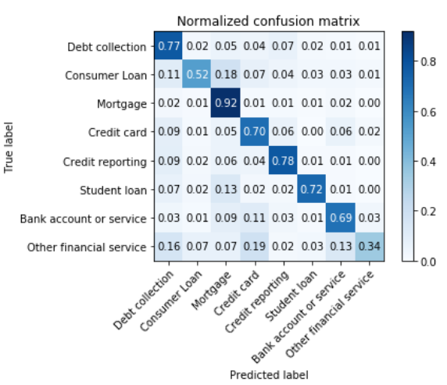
Customer complaints
Word and sentence embeddings
BERT sentence embedding + stacked dense layers
Test accuracy: 0.76

Slide 9
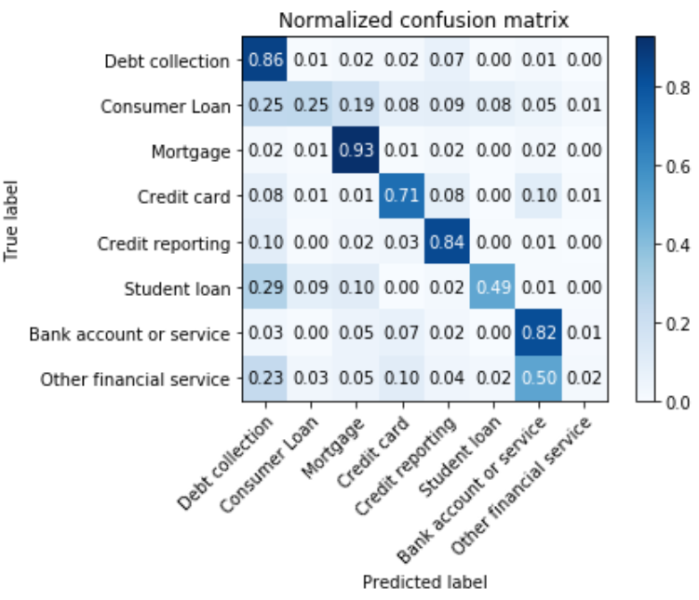
Customer complaints
Word and sentence embeddings
Google Word2Vec word embedding + convolution layer + 4 stacked dense layers
Test accuracy: 0.77

Slide 10
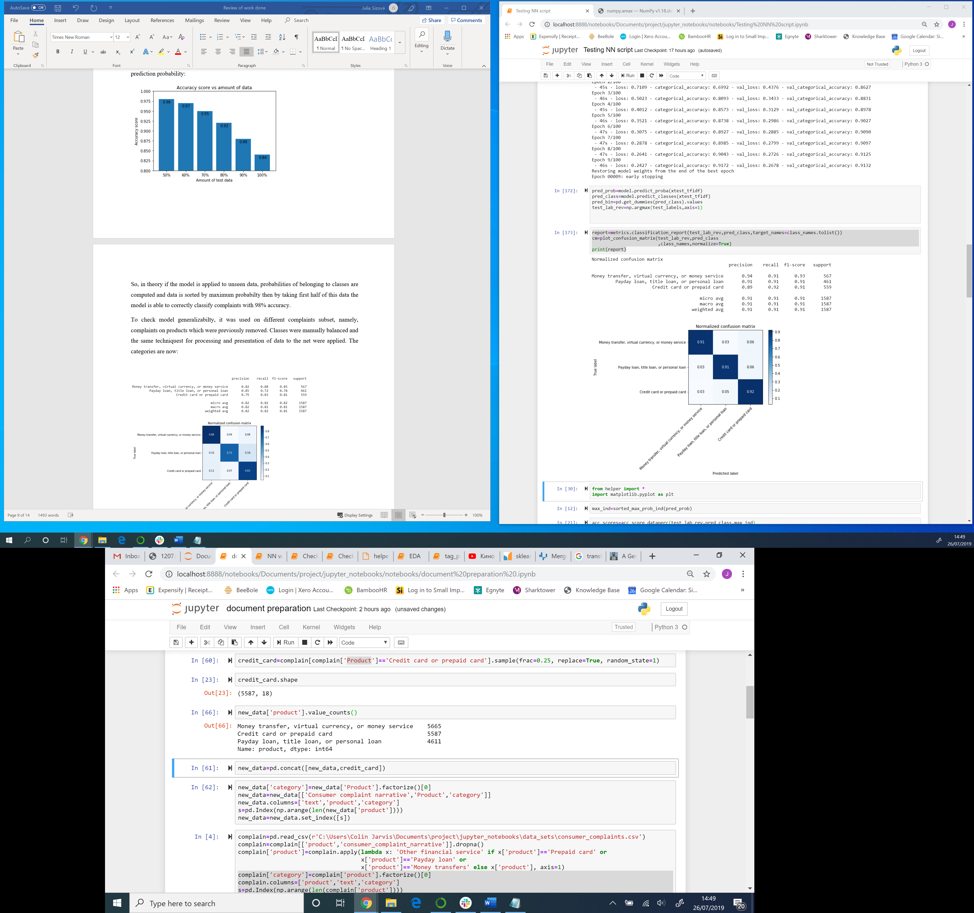
Customer complaints
Transfer learning
A new data sample was extracted from the original data set
Objective: check if the best performing model is able to generalize to new data if fine-tuned
Situation simulated: few observations for training - data split into 1.2% - 1.8% - 97% train validation test sets
Baseline accuracy: 0.36

Slide 11
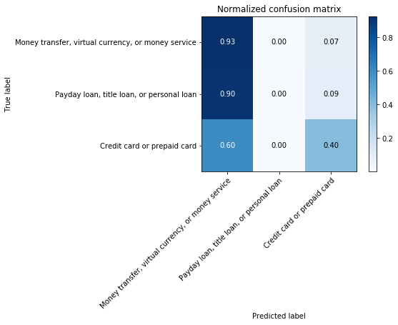
Customer complaints
Confusion matrix from transfer model (test set)
Transfer learning
Model with tf-idf vectorization and stack of 5 fully connected layers
The last layer was replaced by 3-way softmax layer
First 2 layers are frozen and 2 next layers are allowed to train
Test accuracy: 0.47
Full model trained on the same data set gives 0.75 test accuracy, overfits very much
Notes:
Maybe tf-idf is bad for transfer learning?

Slide 12
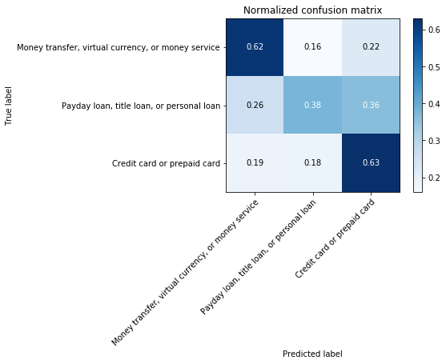
Customer complaints
Confusion matrix from transfer model (test set)
Transfer learning
Model with Google word2vec embedding + convolution layer + 4 dense layers
The last layer was replaced by 3-way softmax layer
First 2 layers are frozen and 2 next layers are allowed to train
Test accuracy: 0.55
Full model trained on the same data (with embeddings computed specifically for this data) set gives 0.51 test accuracy, but overfits quickly
Notes:
Assumption seems to work, but need more careful check

Slide 13
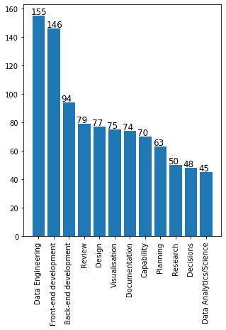
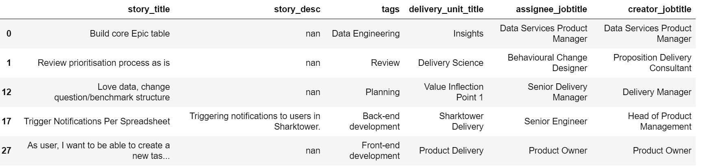
Sharktower data
Sharktower stories were tagged into 16 categories
1075 stories were tagged
Classes with <45 observations were not considered (12 classes left)
Variables considered: story title, story description, delivery unit title, assignee job title, creator job title

Slide 14
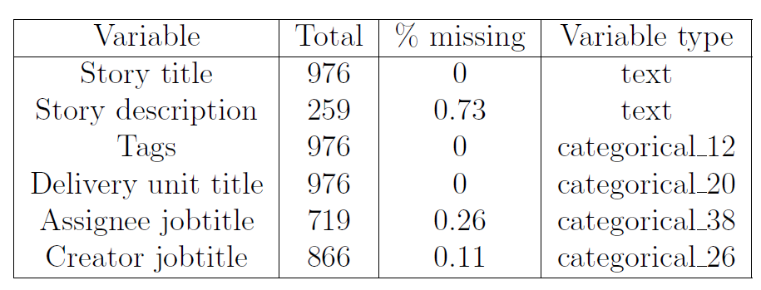
Sharktower data
Data preparation
Texts were cleaned from staff names, client names, URLs, stop-words, punctuation and lemmatized
Text vectorization: Tf-idf
Category vectorization: one-hot encoding
Task: predict tag based on available variables
Classifier: Logistic regression with L2 regularization, One vs All ensemble method
Baseline accuracy: 0.16

Slide 15
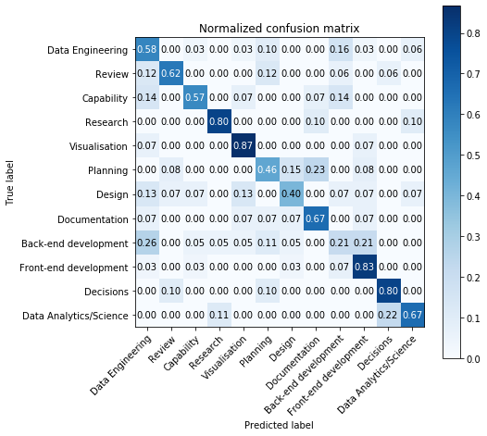
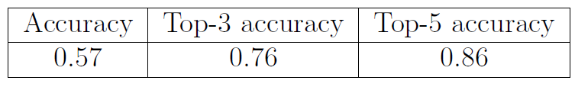
Sharktower data
Confusion matrix for logistic regression on test set
Results
Variables chosen: story title & story description
Test scores

Slide 16
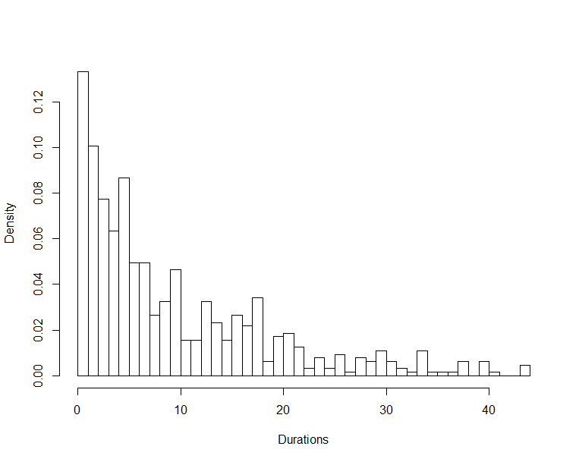
Sharktower data
Duration analysis
Durations were computed for each story
Overall duration is assumed to come from Gamma distribution
Data was split into classes and durations from each class are also assumed to come from Gamma distribution

Slide 17
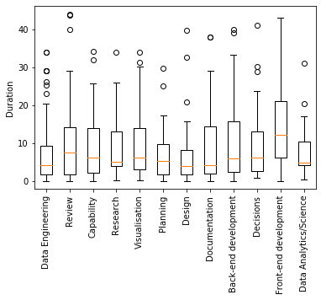
Sharktower data

Slide 18
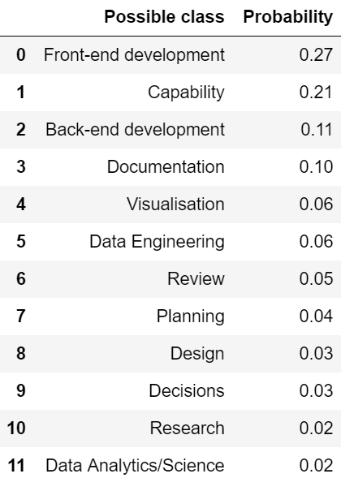
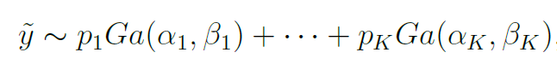
Sharktower data
Each new story duration is assumed to come from a mixture of Gamma distributions with probabilities obtained from classifier:
Assume a new story with probabilities of class membership shown in table ->

Slide 19
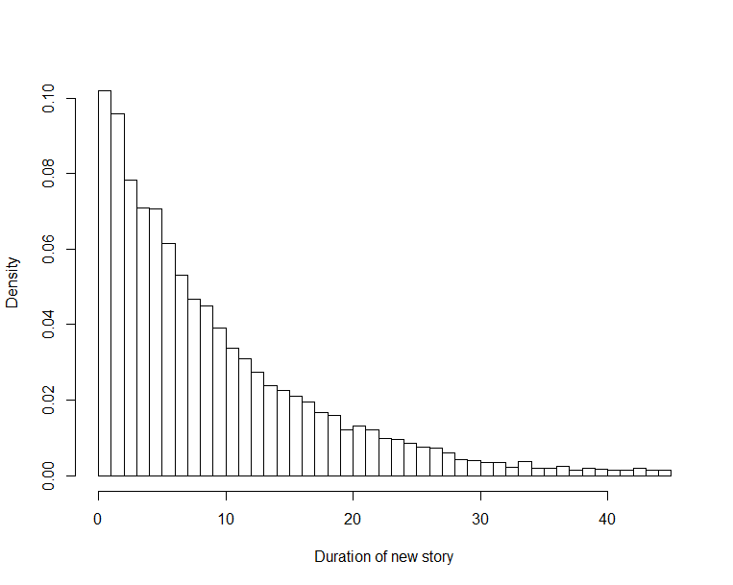
Sharktower data
New story duration distribution
Sample from corresponding mixture of Gamma distributions

Slide 20
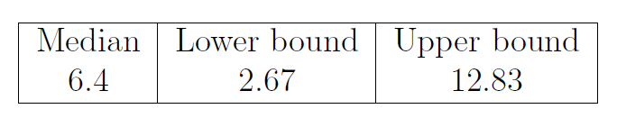
Sharktower data
Duration estimates
Estimates for this story duration:
Since a sample from distribution is available can estimate probability of completing a story within first d days :
Number d of days | Probability of completion
1 | 0.1
6 | 0.48

